Slide 1
Ds3231 RTC
Student name: Rula Al-fadhli

Slide 2
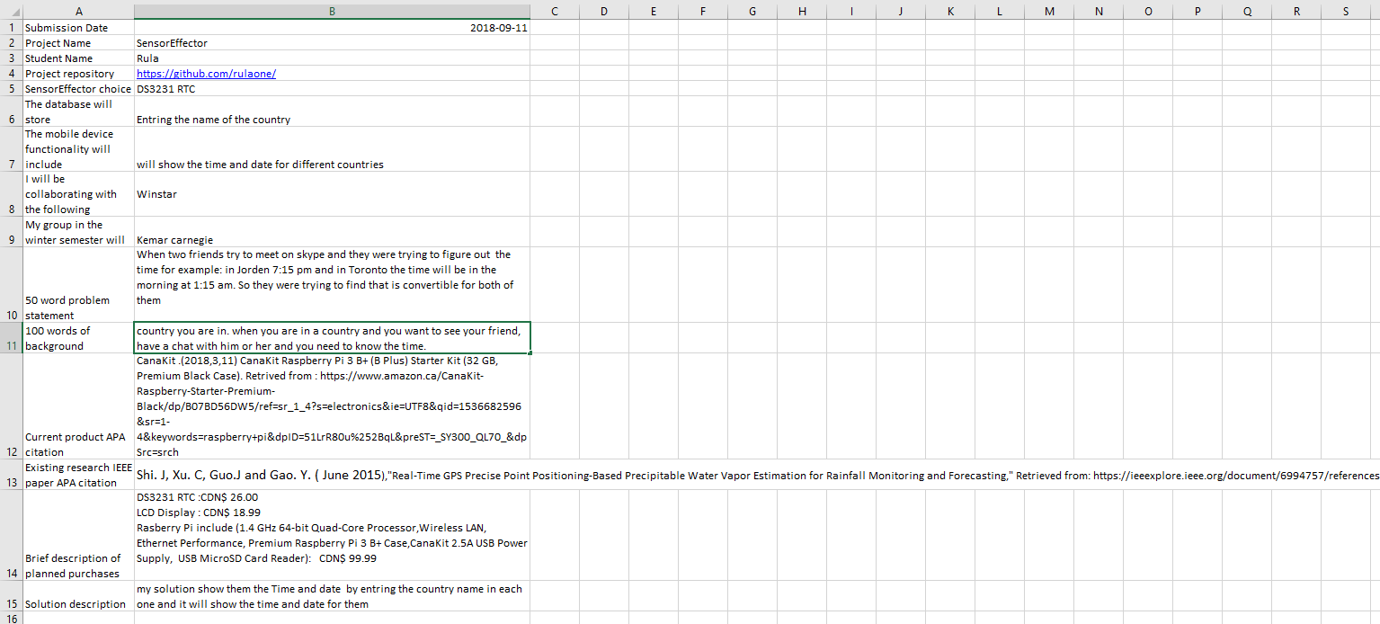
Introduction: proposal

Slide 3
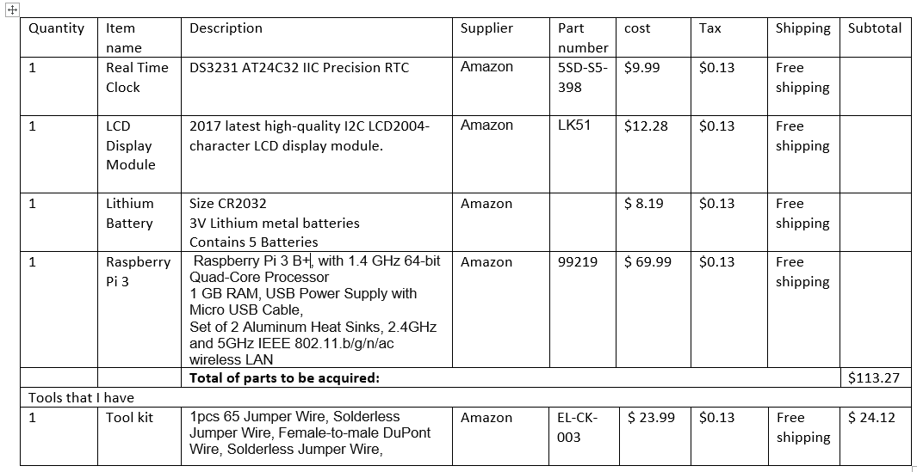
Budget

Slide 4
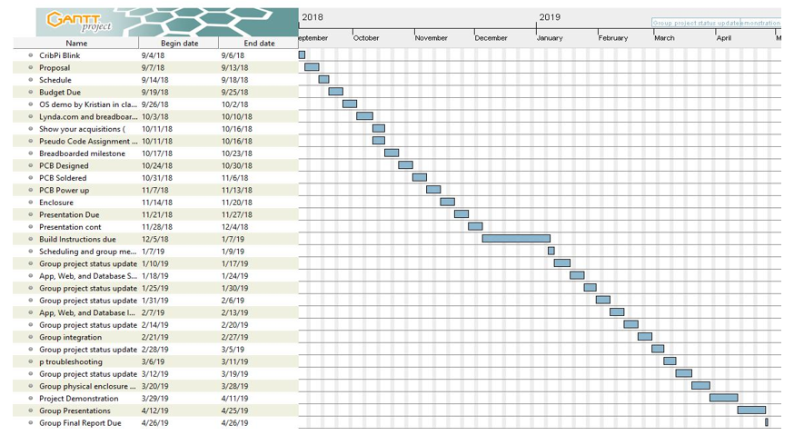
Schedule

Slide 5
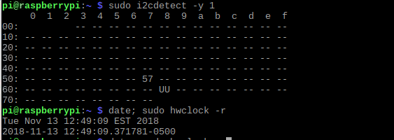
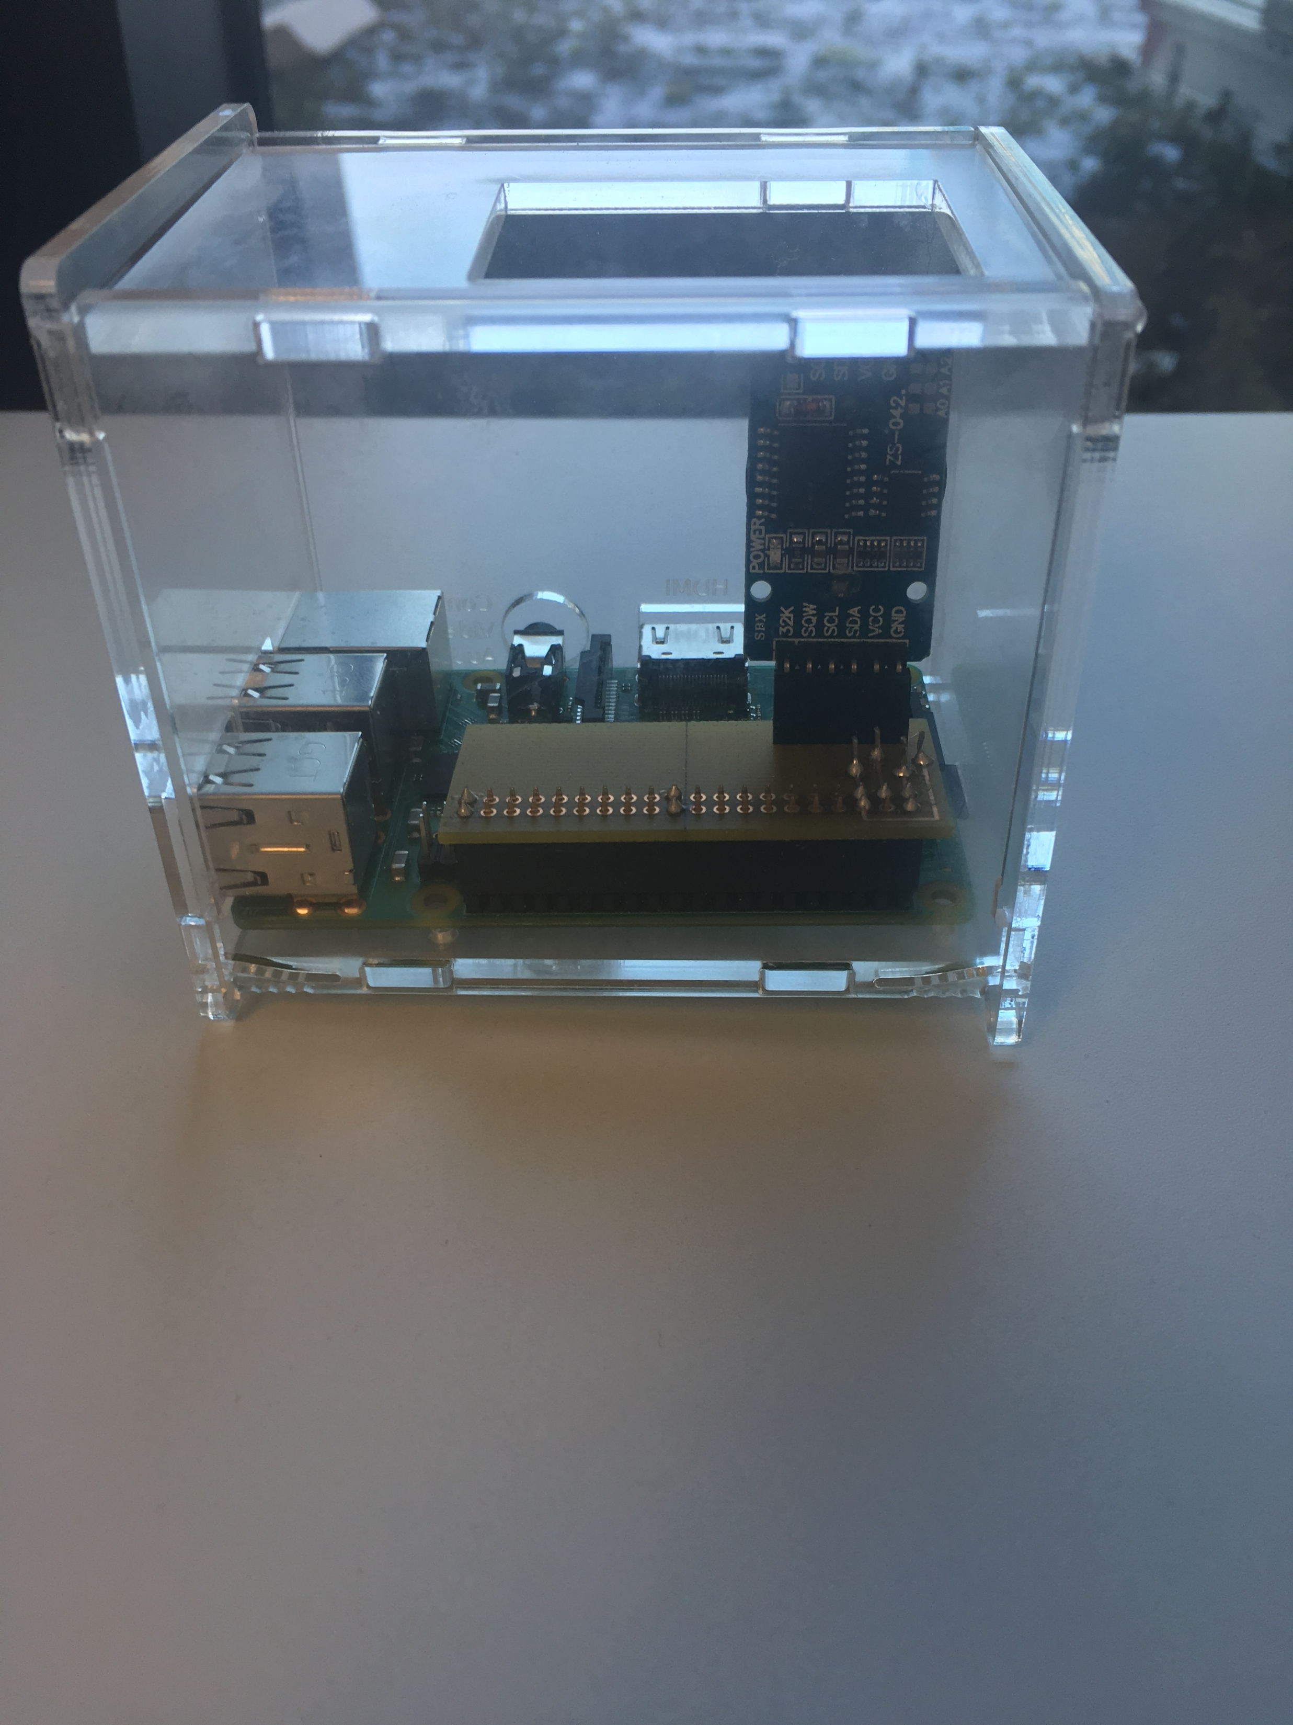
Images
Screen capture of address and image of reading/writing to the sensor.
Enclosed hardware

Slide 6
Course knowledge
Grant Chart:
Intro to software engineering
Making the circuit :
Electronic Devices and Circuits.
Electric Circuit.
Blog :
Internet Programing
ESL
Test code :
Unix scripting
Embedded system.

